Slide 1
NBAC TSC Slides 27 February 2025 Meeting

Slide 2
27 February 2025 NBAC TSC Agenda
27 February 2025 NBAC TSC Agenda
1:00 NBAC Chair (s) Opening Remarks – Mr. Kamran Atri, Thomas Krul & Paul Wormeli
Webinar 22 May – Paul Wormeli
NDR 6.0 PSD01 - approved
Model Version 6.0 PS02 requires additional updates
PGB Vote on Hackathon under review
Domain/Sub-Committee Outreach - Chairs
NBAC Issues Kanban Board -Steve Sullivan
https://github.com/orgs/niemopen/projects/7/views/2
1:10 NIEM Management Office (NMO) Update – Mr. Steve Sullivan
Hackathon details – Steve Sullivan
Reveal Summit – October 2025 Planning
AM 8 October
PGB Meeting Synopsis
OS Use Statements of Use
1:20 NTAC Update – Ms. Christina Medlin
API 2.0
1:30 Communications & Outreach NMO Sub-Committee update – Paul Wormeli
1:35 Community Updates - all
1:40 Questions/Final Remarks
Slides available at 30 January Minutes folder, NBAC Admin Repo
https://github.com/niemopen/nbac-admin/tree/main/nbac-meeting-minutes

Slide 3
Webinar (DRAFT)
Date/Time: 22 May 1-3 PM EDT
Host: IJIS
Venue: TBD
Draft Agenda:
1:00 Welcome and relevance-Maria
1:05 Introduction to the new NIEM--Katherine
1:15 New NIEMOpen Version 6.0 (10 min) - Christina
1:25 CMF/CMF Tool (15 min, includes demo) – Scott Renner
1:40 API 2.0 – Christina
1:50 NDR 6.0 and toolkit+ future updates - Renner
2:00 The future of NIEMOpen with OASIS – Jim Cabral
2:10 NIEM on the ground – Brian Griffith, FBI CJIS
2:20 New dimensions for NIEMOpen in ontologies – Sonoma County
2:30 The future plans and resources - Katherine
2:35 Q&A (panel with Katherine, Maria, NBAC and NTAC chairs)
3:-00 Close

Slide 4
Announcements
NIEMOpen NDR v6.0 PSD01 Approved
Submitted for Publication to OASIS Library
https://github.com/niemopen/niem-naming-design-rules
NIEM Model Version v6.0 PS02 requires updates before next vote: https://github.com/niemopen/niem-model/tree/2afcd93dc4061e825df8c2b3bf44557bbd4cb976

Slide 5
NIEM Management office
Hackathon details – Steve Sullivan
Reveal Summit – 8 October 2025, Planning Started, National Press Club, Washington, DC
PGB Meeting Synopsis
OASIS Standard – Model Version 6.0

Slide 6




NIEMOPEN Hackathon
Fueling Data Standardization

Slide 7


“OPENHax”
Model
Initial Sponsor: OASIS NIEMOPEN Project
Additional Sponsors: Government & Industry organizations
Operator: GenHax
Strategic Goals over the next 3 years:
Engage with businesses to accelerate cross-domain interoperability at the data level
Promote standard awareness, adoption and implementation
Fund the standard through increased sponsorship from Additional Sponsors
Advance use of NIEM for AI through Knowledge Graphs (providing contexts and semantics for training AI models)

Slide 8
Recommendation
Year 1- 1 hack - $50K fixed seed + $50K variable from Additional Sponsors + Funding goal for NIEMOPEN
App Creation
Marketing, Branding, Community Engagement
Acquiring Sponsors for NIEMOPEN: $50K to break even on the cost of the hack (Plan).
Stretch goal: Additional NIEMOPEN Sponsorship $50K.
Hosting Hackathon events (pre-, during and post-event)
Post event activities (employee “Journeys”, report metrics, sponsors, social media)
Year 2 & 3 - 2 hacks - $50K fixed + $50K variable from Additional Sponsors + Funding goal for NIEMOPEN: $200K
Same as Year 1 + additional revenue from employee “Journeys”

Slide 9
OPENHax Elements
Overview of the operational elements we’ll set up for OPENHax
Hackathon Format:
Hybrid: Depending on partners who might want to make it partly local + facilities that NSF might bring.
Duration: Workshop(s) a few hours. Hackathon: either a full week, or 2 days a week for 3 weeks.
Onboarding: Stakeholders will register and be activated on the app (i.e. app.openhax.org)
Domain groups: NIEMOPEN Domain Groups: will be set up and leveraged on the app.
Journeys: Engagement activities for stakeholders after the hackathons to drive impact for 3 months
Application: hackathon stakeholders will join the OPENHAX app and have related paid or free seats and features enabled for them
Hackathon Stakeholders:
Organizer: NIEMOPEN
Operator: GenHax
Initial Sponsors: DoD, OASIS (TBD)
Sponsors: Companies supporting OPENHax financially
Donators: Companies driven to donating to NIEMOPEN through the hackathon
Partners: Organizations supporting NIEMOPEN or/and OPENHax in-kind (communication, resources)
Participants: App users taking part in hackathon teams for days of work, in view of producing solutions
Mentors: App users registering to mentor others, for a few hours only, not part of teams
Speakers: Reputed individuals invited to speak during the hackathons
Leaders: Reputed individuals invited to participate in Ideathon Leader Workshops before the hackathons

Slide 10
OPENHax 2025 Timeline
Planning & Preparation
Define Objective
Target Audience
Theme/Focus
Ideathon
2 hour leadership workshop
Bring together leading sponsors, researchers, influencers.
Post-OPENHax
Judging, winners, prizes
Post-Event social media impact promotion. Next hack’s ideathon.
Sponsor follow-up, Reporting
Feb-Sep 2025
Sep 2025
Jan-Feb 2025
June 2025
Sep - Dec 2025
Development & Marketing
Build your Application, Website, Branding material, Event Calendar
Talent acquisition: Participants and Mentors: Direct Campaigns, Social Media, Colleges & Universities, Developer Platforms, Direct Recruitment, Partners
Sponsor engagement- existing and new
OPENHax
Kickstart and operate for 2 weeks
Onboard & Build teams
Manage community & run events
Organize Mentor sessions
Aggregate resources
Gamify with milestones & badges
Activate & drive success with activities
Pitch solutions/challenge
Launch Campaigns for next Quarter’s hack

Slide 11
PGB Synopsis
Motions | Description | Vote | Notes
1/6/25 - PGB Notified of Upcoming Motion to Approve NDR by Simple Majority Vote & Publish to OASIS Library | (Chair) Notification of vote on the motion to approve NIEM Naming and Design Rules (NDR) Version 6.0 PSD01 and submit for publication | N/A | https://github.com/niemopen/niem-naming-design-rules Vote scheduled 20-25 Jan 2025
1/25/25 - NIEM Naming and Design Rules (NDR) Version 6.0 PSD01 Vote | (Chair) Motion to approve NIEM NDR Version 6.0 PSD01 and submit for publication by simple majority via email. | Approved, 9 votes to approve. 4 abstentions. | Vote Conducted 20-25 Jan 2025 1/28/25 - Submitting request to publish.
1/28/25 – PGB Notification of Special Majority Vote & Request Ballot for Model Update & Publish to OASIS Library | (Chair) PGB Notification of vote on the motion to approve NIEM Model Version 6.0 PS02 and submit for publication | N/A | https://github.com/niemopen/niem-model/tree/2afcd93dc4061e825df8c2b3bf44557bbd4cb976 Vote/ballot scheduled for 11-18 Feb 2025
30 January 2025 Agenda | (Chair) Motion to approve 30 January 2025 Agenda. | Approved
14 November 2024 DRAFT Minutes | (Chair) Motion to approve 14 November 2024 PGB meeting minutes. | Approved

Slide 12
PGB Synopsis
Motions | Description | Vote | Notes
Q2 & Q4 PGB Meeting Dates | (Darcy Staley) Motion approve changing CY 2025 Q 2 & Q4 PGB Meeting Dates from 24 April 2025 to 29 May 2025 and from 28 October 2025 to 13 November 2025 | Approved
CY 2025 Meeting Dates Revised
Q2 | MAY 29 | 2 – 4 PM | EDT
Q3 | JUL 31 | 2 – 4 PM | EDT
Q4 | NOV 13 | 2 – 4 PM | EDT
NDR Version 6.0 PS Model Version 6.0 OS | (Darcy Staley) Motion to proceed: Advance NDR v6.0 PSD01 to PS, & Upon approval of NIEM Model v6.0 PS02 proceed to advance to OS | Approved
Motion to consider funding Genhax hackathon | Genhax brief , timeline, and proposal | Approved of concept pending contract details | Year 1- 1 hack $50K fixed seed + $50K variable from Additional Sponsors + Funding Goal for NIEMOpen

Slide 13
Niem model 6.0 oasis standard (OS)
PS02 – revisions needed
OS Process - https://www.oasis-open.org/policies-guidelines/open-projects-process/#oasis-standard-approval-external-submissions
3 Statements of Use - https://www.oasis-open.org/policies-guidelines/oasis-defined-terms-2018-05-22/#dStatementUse

Slide 14
Specification workflow and timeline
Request a spec template from OP Admin
Decide on editor(s)
Editor’s job is to capture the intentions of the project team/TSC
Editor’s Manual starting at https://docs.google.com/document/d/1lTartcAzlqidzrCxuXFFiwdRDKRipqMnNsMS24SZdjg/edit
Create Project Specification Draft (PSD)
PGB can decide to advance PS to OASIS for consideration as an OASIS Standard
Requires 3 Statements of Use and a Special Majority Vote run by OP Admin
60-day public comment period
The Project Specification (PS) is put to OASIS Members in a 14-day Call for Consent. If no objections, work becomes an OASIS Standard, eligible for submission to other SDOs
PSD produced with oversight of TSCs
TSC recommends PSD to PGB
PGB requests Special Majority Vote be run by OP Administrator
PS has the same standing as an OASIS Standard
7 days minimum - 2/3 must vote yes, no more than 1/4 nay votes
OP Admin publishes PS to the library and announces/promotes
Project Specification Approved by PGB
PGB approve PS as Candidate for OASIS Standard
OASIS Standard approved by members under Call for Consent
Project Specification
Draft(s)^{1,3}
DRAFT PSD
PGB Approval²
PS
PGB
Approval²
PS Candidate OS
PGB
Approval²
60 Day Public Review/ Comment
Call for
Consent
OASIS Standard
14 Days
Notice of Vote
14 Days
Notice of Vote
3 Statements of Use
GitHub Repo
OASIS Project Library
docs.oasis-open-projects.org
Special Majority Vote 7 Days
Working Draft
3-12 Months
Statements of Use
1-6 Months
2-3 Weeks Publish
Candidate Standard
60 Days
14 Days
Publication &
Announcement
1-2 Weeks
Notes:
NOTES:
TSCs may go through multiple iterations of PSDs before arriving at a final version.
There is a 2-week notice requirement before Voting to approve a PSD or PS or advance to OS.
Each work product proceeds through the process independently unlike Release or Group Releases.
DEFINITIONS:
“Project Specification” is one or more Release(s) or subsets of Release(s) of an OASIS Open Project properly prepared and nominated by the Project Governing Board (PGB) and approved as such by the Members of the PGB by a Special Majority Vote.
“Special Majority Vote” is a vote in which at least 2/3 (two thirds) of the eligible voters vote “yes” and no more than 1/4 (one fourth) of the eligible voters vote “no”. These numbers are based on the total number of eligible voters in the committee. Abstentions are not counted. For example, in a Technical Committee in which there are 30 Voting Members, at least 20 Voting Members must vote “yes” for a motion to pass; but if 8 or more vote “no” then the motion fails. All Special Majority Votes must be conducted via electronic ballot by the OASIS TC Administrator.
“OASIS Open Project Administrator” is the person or persons representing OASIS in administrative matters relating to Open Projects, Open Repositories, or Project Governing Boards. All official communications must be sent to op-admin@oasis-open.org.
OPEN PROJECT LIGHTWEIGHT RULES
11. Progression of Project Work
11.1 In addition to making available the contributions provided by Contributors, via their Project Repositories, Projects may designate specific portions of their output as official Releases, Group Releases, Project Specification Drafts or Project Specifications, and nominate them for further advancement, on the terms set forth in Sections 11, 12, 13 and 14.
12.2 Where the PGB or a consensus among the Contributors indicates that a specific set of contributions should be formally considered as a Release, Group Release, Draft Project Specification or Project Specification, then in preparation for that consideration, the Maintainers shall arrange the relevant material in the relevant Project Repository or repositories so that the set can be accessed and referenced as a distinct branch (a Designated Branch).
12. Releases and Group Releases
12.1 Releases. The PGB may act to approve a Designated Branch as an official Release of the Project, after giving notice to all Contributors via the Project Tools at least fourteen days prior to initiating a PGB vote or consensus call. Such approval decisions are subject to the process, notice and transparency provisions of these rules. Any product of the Project that is composed from contributions to the Project Repositories, of any nature, is eligible for approval as a Release of the Project.
12.2 Group Releases. When desirable to aggregate outputs, the PGB may act to approve any set of the Project’s Releases or subsets of Releases as an official Group Release of the Project, after giving notice to all Contributors via the Project Tools at least fourteen days prior to initiating a PGB vote or consensus call. Such approval decisions are subject to the process, notice and transparency provisions of these rules. Group Releases may include multiple Releases that bear different Applicable Licenses. Aggregate contributions by Maintainers or others which are prepared as potential Project Specifications should instead be approved as Project Specification Drafts, as provided below.
12.3 Licensing. Releases and Group Releases bear only the license rights and covenants provided for each of the contributions included there, as evidenced by the relevant repositories’ Applicable License(s) and the CLAs.
13. Project Specifications
13.1 In order to progress a Release or Group Release by the Project as a Project Specification Draft (or PSD) or a Project Specification (or PS), the PGB and the contents of the release(s) must satisfy the additional criteria of this Section.
13.2 In order to be advanced through the approval process, a proposed Project Specification must conform to the Project Specification template provided by the Open Project Administrator, which includes methods for indicating the relevant Designated Branches and Applicable Licenses. Proposed Project Specification Drafts also should conform to that template, to the extent possible.
13.3 Project Specification Drafts. A PGB having at least Project Approval Minimum Membership may act to approve any set of contributions to the Project, including from its Releases or Group Releases, as an official Project Specification Draft, after giving notice to all Contributors via the Project Tools at least fourteen days prior to initiating a PGB vote or consensus call. Such approval decisions are subject to the process, notice and transparency provisions of these rules.
13.4 Project Specifications. A PGB having at least Project Approval Minimum Membership may act to approve any Project Specification Draft as a Project Specification, by satisfying each of the following requirements:
(a) Written notice of that nomination must be given by the PGB to all those involved with the Project and the Open Project Administrator at least fourteen days prior to initiating a ballot. The ballot must be conducted by a Special Majority Vote of the PGB. The approval decision is subject to the process, notice and transparency rules set forth in these rules and the content requirements noted below.
(b) Any machine-executable instructions in a specific computer language (code) that are included in the Project Specification must be composed only of one or more Releases or Group Releases bearing Implementer-Class Licenses.
(c) Any guidance, descriptions, processes, models for the behavior of a system or service, or other content that is not machine-executable, and is included in the Project Specification, must be composed only of contributions (which may include Releases or Group Releases) previously made to a Project Repository.
(d) The proposed Project Specification will be subject to review and confirmation of conformance by the Open Project Administrator before the approval ballot is opened.
13.5 Upon successful conclusion of the Special Majority Vote, the Open Project Administrator must give public written notice thereof, which constitutes approval, and thereafter will publish the Project Specification to the OASIS Library.
13.6 Licensing. Project Specifications bear the license rights and covenants provided for each contribution included there, as evidenced by the relevant repositories’ Applicable License(s) and the CLAs, as well as the Specification Non-Assertion Covenant. Project Specifications may bear more than one Applicable License, when composed from Releases or Group Releases from multiple Project Repositories that have different Applicable Licenses.
13.7 Implementations of all kinds are welcome (partial or complete; prototype, proof-of-concept, example, model, or reference implementations), provided that PGBs may not designate any single implementation of a Project Specification as exclusive or privileged.
14. OASIS Standard Approval and External Submissions
Project Specifications are eligible for and may be submitted for approval as OASIS Standards, under the following conditions:
(a) After three Statements of Use referencing the PS have been presented to the PGB, a PGB having at least Project Approval Minimum Membership may approve the PS as a candidate for OASIS Standard in the same manner, and subject to the same requirements, as apply to Committee Specifications as provided in Section 3.8 Approval of an OASIS Standard of the OASIS TC Process. Procedural requirements applicable to TCs in that rule apply to the PGB for this purpose, including the Special Majority Vote required to nominate a Project Specification for OASIS Standard. However, a candidate for OASIS Standard submitted by an Open Project shall be subject to the distinct licensing terms in these rules, and not the licensing terms in the OASIS IPR Policy for TCs.
(b) Upon a successful conclusion of that PGB vote and all other requirements, the OASIS TC Administrator shall proceed with public review and a call for consent as provided in Sections 3.8.2 and 3.8.3 of the OASIS TC Process. An OASIS Standard submitted by an Open Project and approved as provided above is eligible for further external submissions as provided in and subject to the requirements in the OASIS Liaison Policy. The PGB must have at least Project Approval Minimum Membership at the time of any such action or approval; the other procedural requirements applicable to TCs in that policy apply to the PGB for this purpose.

Slide 15
NTAC Update
API 2.0

Slide 16
Niem API 2.0 and NIEM Toolbox – 1
Transition legacy NIEM tools into updated open source products. Move key functionality out of tools into the API for reusability.
Feature | NIEM API | NIEM Toolbox
(Background) | Java / Spring Boot and PostgreSQL database Hosted via GTRI | Nuxt (JS) SPA Hosted via GitHub Pages (free)
Transforms | Transform models into other formats Inputs – CMF or NIEM XSD Outputs – CMF, XSD, JSON Schema, or OWL Leverages the CMF tool | Form to upload file and set options API request Download results
Validation | XSD – Validate and check NDR conformance XML – Validate against provided schema CMF – Validate against schema (NTAC) IEPD catalog – Validate against schema (NTAC) XML catalog – Validate against schema (OASIS) | Form to upload file and set options API request Download and view results
Migration | Migrate from one supported model version to a more recent version Can iterate over multiple versions in one call Accepts input and generates results as CMF | Form to upload file and set options API request Download and view results
Done
In progress

Slide 17
Niem API 2.0 and NIEM Toolbox – 2
Transition legacy NIEM tools into updated open source products. Move key functionality out of tools into the API for reusability.
Feature | NIEM API | NIEM Toolbox
Model data | Return information about models, versions, namespaces, properties, classes, datatypes, and facets Supports NIEM and published community models NIEM data 1.0 – 5.2 currently available | Browse model data View information about components View information about curated list of common components
Search | Search properties, types, and codes Supports fuzzy searching, including tokens and substrings Filter results by namespace Component-specific search fields | Search models View results View information about components
Model management | Add, edit, and delete model content Model and component QA Load change request spreadsheets Generate release artifacts Generate model stats
Done
In progress

Slide 18
Backup

Slide 19

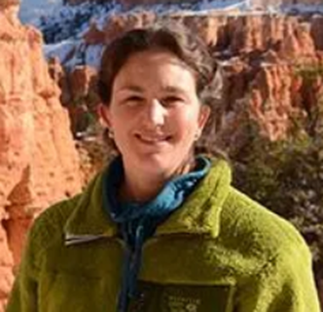


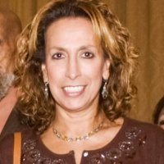
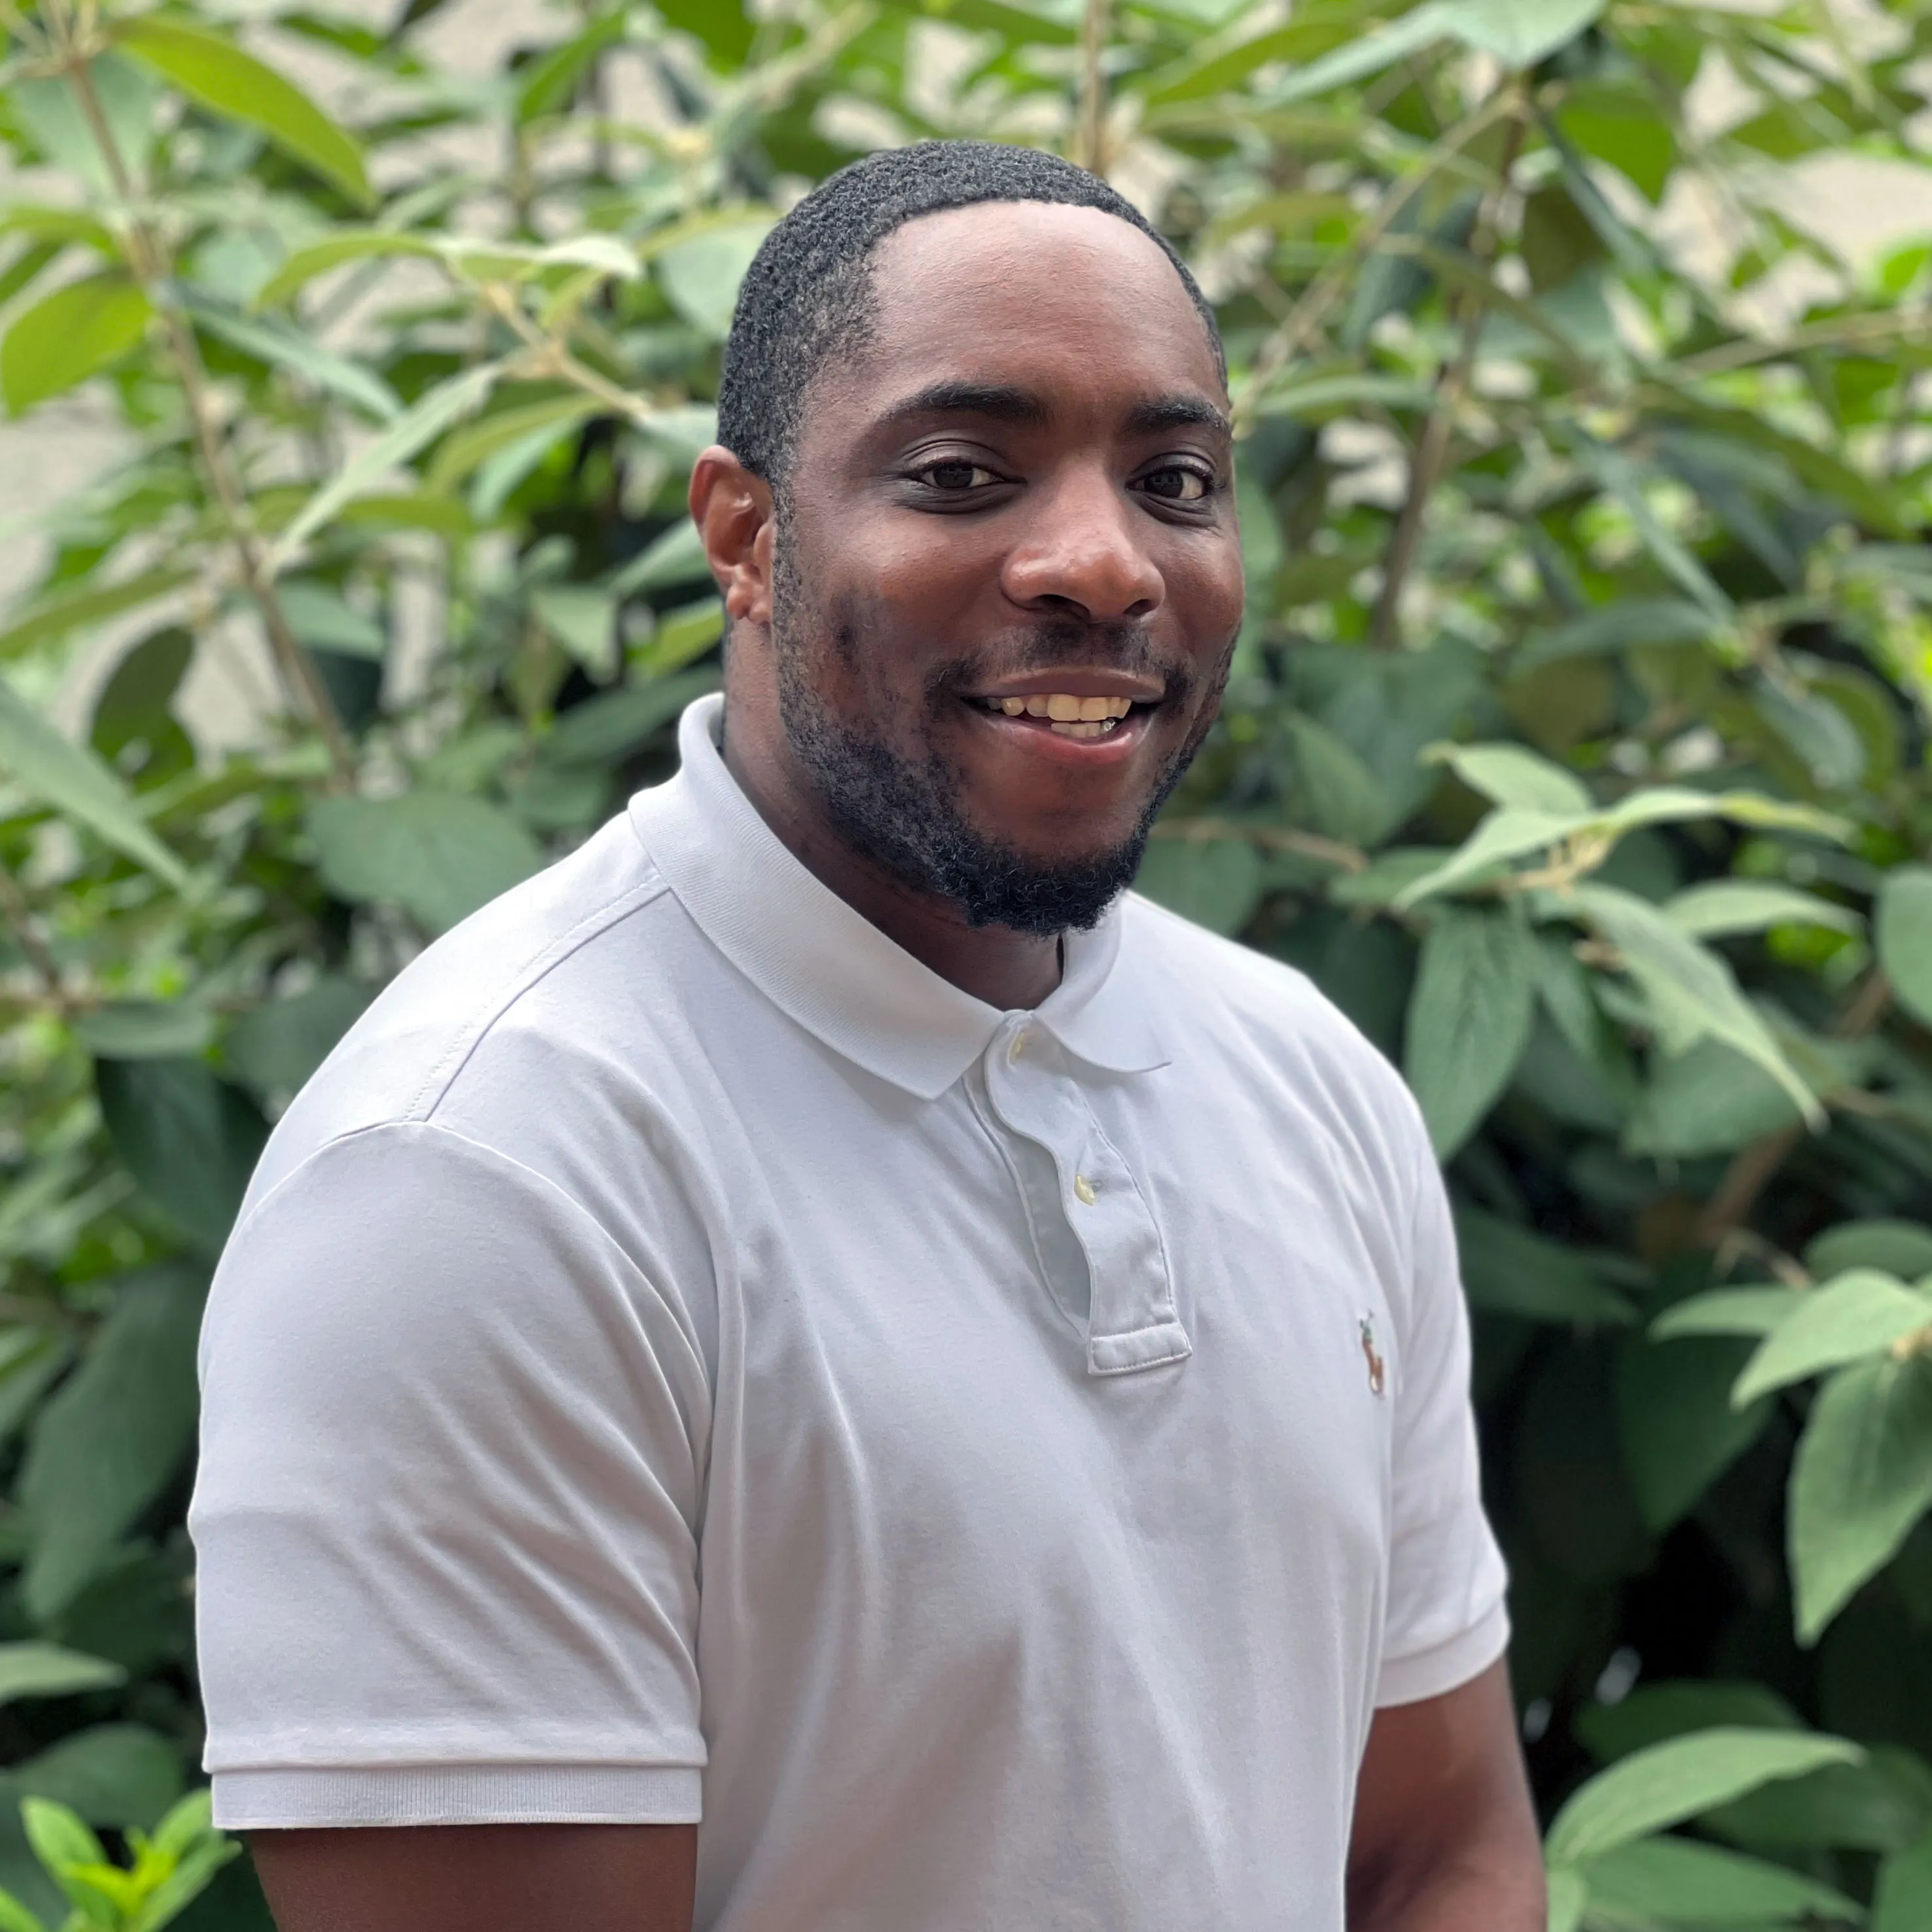
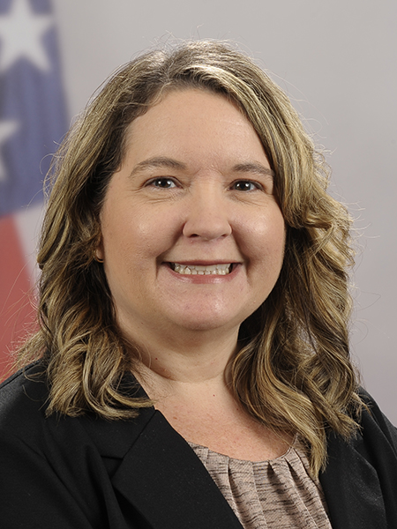
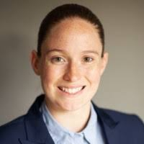
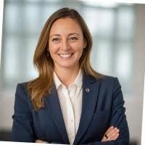
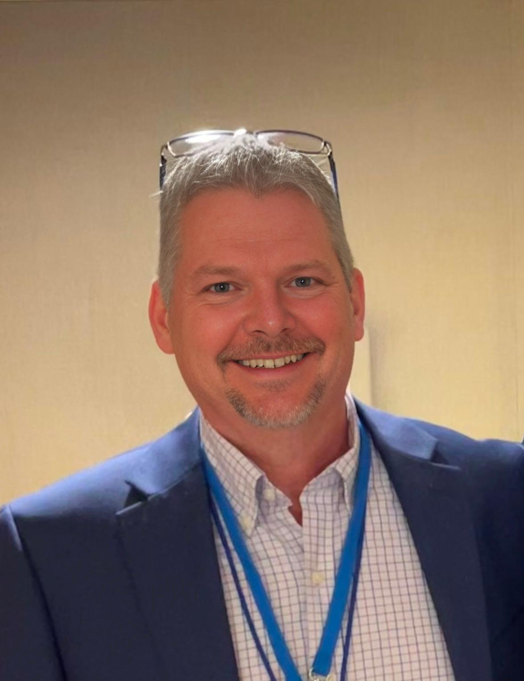
PGB APPOINTED VOTING MEMBERS
Ms. Katherine Escobar
PGB Chair
Deputy Division Chief, Data and Standards Division at Joint Staff J6 and NIEM Managing Director
Ms. Christina Bapst-Stump
Science and Technology Directorate, US Department of Homeland Security
Mr. Gary Egner
Director Business Development, Equivant
Mr. John Wandelt
Principal Research Scientist, Georgia Tech Research Institute
Ms. Maria Cardiellos
Executive Director
Integrated Justice Information Systems Institute
Mr. Payton Lamb
Data Engineer
Commonwealth of Virginia
Office of the secretary of Administration
Office of Data Governance and Analytics
Ms. April Mitchell
FBI It Specialist and Technical Lead of Data Standards in the Criminal Justice Information Services (CJIS) Division
Ms. Erin Partin
Data Scientist, Office of the Principal Deputy Director, National Institute of Justice (NIJ)
Ms. Erica Smith
Data Scientist, Unit Chief – Law Enforcement Incident-Based Statistics Unit, Bureau of Justice Statistics(BJS)
Mr. Tom Welch Director of Information Technology
OHIO HIDTA – Including Northern KY & Western PA
Notes:
Open Project Rules - OASIS Open (oasis-open.org)
5.1 Overall guidance for the Project is provided by its Project Governing Board (or PGB). The PGB is composed of one voting member from each Project Sponsor who elects to appoint a PGB member, and (a) if the PGB has one or more Technical Steering Committees, one voting expert representative from each TSC, elected or appointed by that TSC, or (b) otherwise, the PGB may appoint at least one and no more than two voting expert representatives from its community of contributors. The PGB may create additional non-voting PGB member seats for expert representatives to be elected by the TSC or appointed by the PGB. The PGB membership of all such members of any type is conditioned on satisfaction of the CLA requirement of Section 5.2. Voting status on the PGB may be affected by the provisions of Section 5.7.

Slide 20
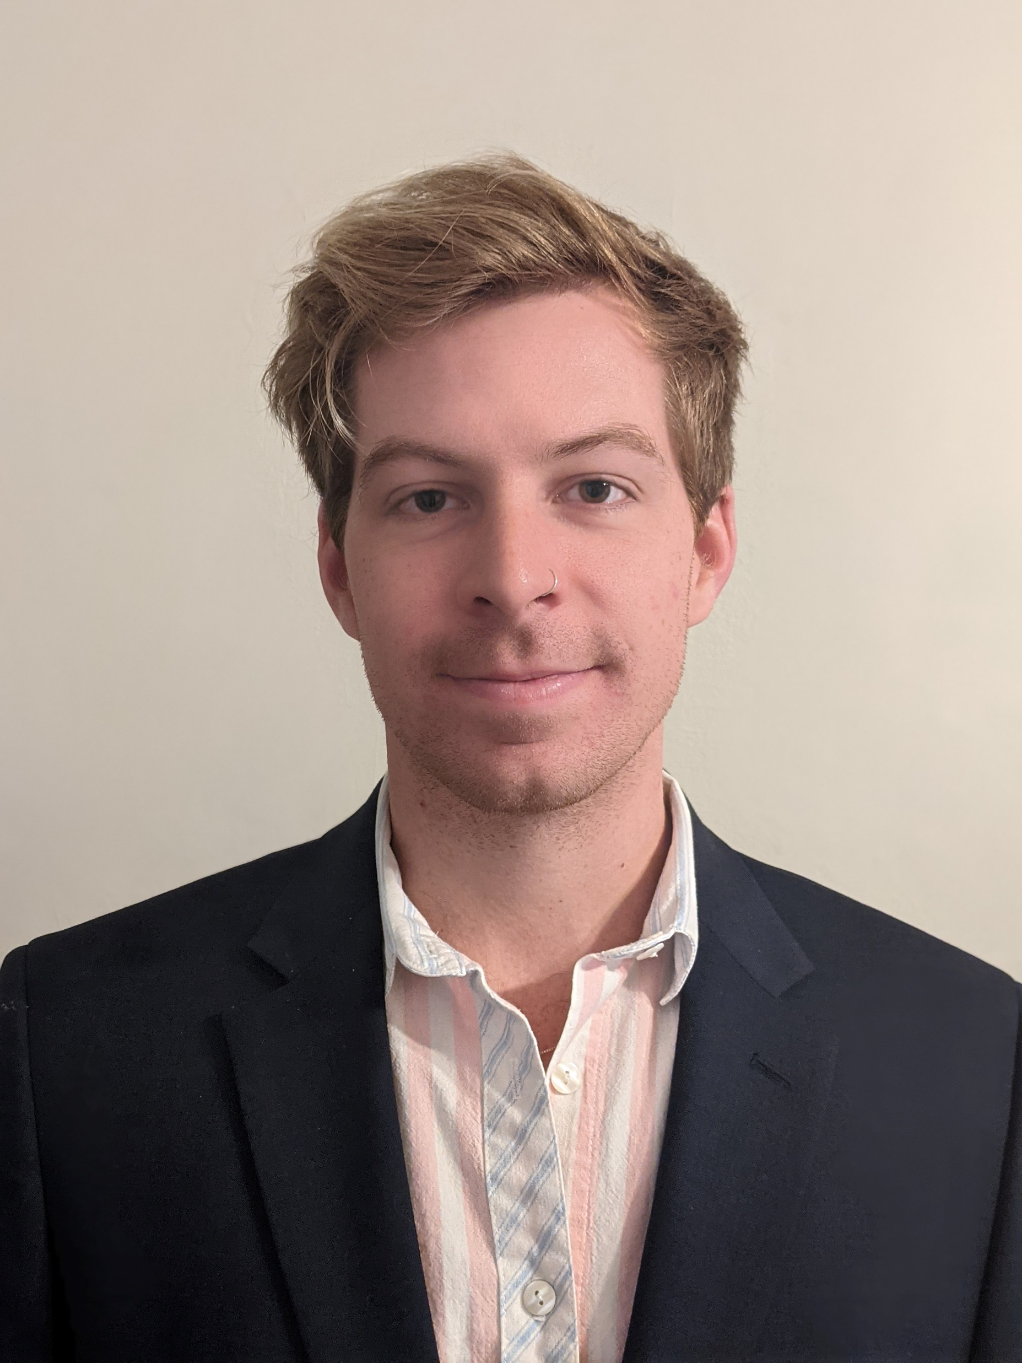

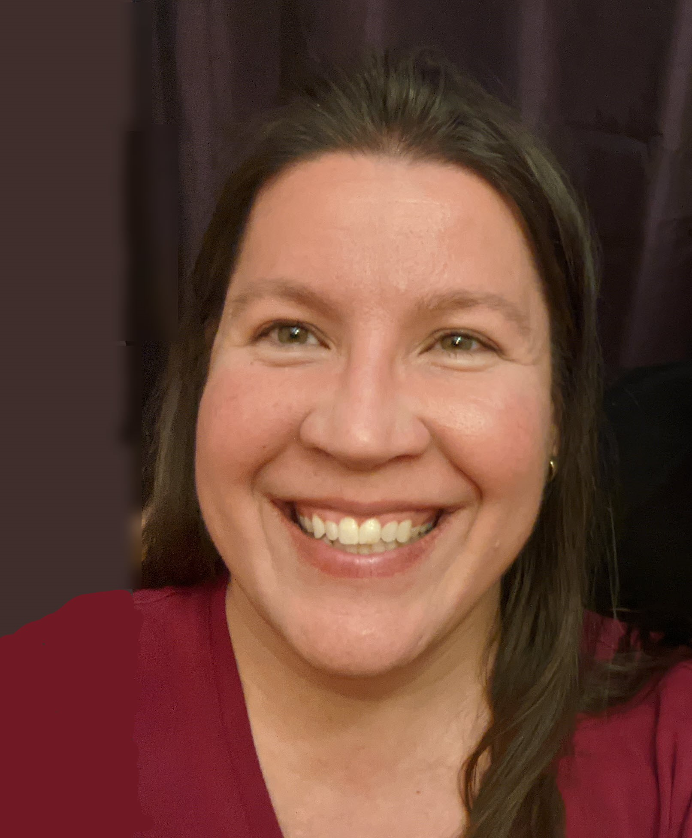

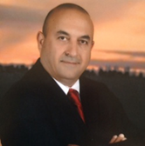

PGB EXPERT VOTING MEMBERS &
NON-VOTING MEMBERS
PGB EXPERT VOTING MEMBERS
Technical Steering Committees
PGB EXPERT NON-VOTING MEMBERS
Technical Steering Committees
Mr. Kamran Atri
Co-Chair, NIEM Business Architecture Committee TSC
Mr. Paul Wormeli
Co-Chair, NIEM Business Architecture Committee TSC
Mr. Brad Bolliger
Co-Chair, NIEM Technical Architecture Committee TSC
Mr. Thomas Krul
Co-Chair, NIEM Business Architecture Committee TSC
Ms. Darcy Staley
Co-Chair, NIEM Management Organization TSC
Dr. Scott Renner
Co-Chair, NIEM Technical Architecture Committee TSC
Notes:
Open Project Rules - OASIS Open (oasis-open.org)
5.1 Overall guidance for the Project is provided by its Project Governing Board (or PGB). The PGB is composed of one voting member from each Project Sponsor who elects to appoint a PGB member, and (a) if the PGB has one or more Technical Steering Committees, one voting expert representative from each TSC, elected or appointed by that TSC, or (b) otherwise, the PGB may appoint at least one and no more than two voting expert representatives from its community of contributors. The PGB may create additional non-voting PGB member seats for expert representatives to be elected by the TSC or appointed by the PGB. The PGB membership of all such members of any type is conditioned on satisfaction of the CLA requirement of Section 5.2. Voting status on the PGB may be affected by the provisions of Section 5.7.

Slide 21


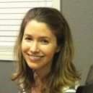



NMO, NBAC, & NTAC TSC Co-Chairs & OASIS Maintainers
TSC | Approved (TSC CHAIRS)
NMO TSC | Ms. Darcy Staley & Ms. Beth Smalley
NBAC TSC | Mr. Kamran Atri & Mr. Thomas Krul, Mr. Paul Wormeli
NTAC TSC | Dr. Scott Renner & Mr. Brad Bolliger
GitHub Repos | Primary | Alternates
NIEM Open | Ms. Christina Medlin, Mr. Aubrey Beach | Mr. Tom Carlson, Ms. Shunda Louis, Mr. Steve Sullivan (pgb-minutes)
NTAC-Admin | Dr. Scott Renner, Mr. Brad Bolliger | Mr. Aubrey Beach, Mr. Tom Carlson, Mr. Jim Cabral, Ms. Christina Medlin, Ms. Shunda Louis
NBAC-Admin | Mr. Steve Sullivan, Mr. Aubrey Beach | Ms. Shunda Louis, Ms. Christina Medlin
NMO-Admin | Ms. Darcy Staley, Mr. Aubrey Beach | Mr. Steve Sullivan, Ms. Shunda Louis
NTAC TSC
NBAC TSC
NMO
TSC
Christina Medlin
Aubrey Beach
Dr. Scott Renner
Brad Bolliger
Steve Sullivan
Darcy Staley

Slide 22








Resources
Follow Us On Twitter
https://twitter.com/NIEMconnects?ref_src=twsrc%5Etfw
Katherine Escobar, katherine.b.escobar.civ@mail.mil, 757-203-8631
Git Repos
NIEMOpen: https://github.com/niemopen/
NTAC TSC
https://github.com/niemopen/ntac-admin
NBAC TSC
https://github.com/niemopen/nbac-admin
NMO TSC
https://github.com/niemopen/nmo-admin
NIEMOpen Slack Channel: https://niemopen.slack.com/
Mailing Lists
NIEMOpen: https://lists.oasis-open-projects.org/g/niemopen
PGB: https://lists.oasis-open-projects.org/g/niemopen-pgb
NTAC TSC: https://lists.oasis-open-projects.org/g/niemopen-ntactsc
NBAC TSC: https://lists.oasis-open-projects.org/g/niemopen-nbactsc
NMO TSC: https://lists.oasis-open-projects.org/g/niemopen-nmotsc
https://www.niem.gov/
https://niemopen.org/
https://www.linkedin.com/groups/1903175/profile
https://www.youtube.com/channel/UCg9qV22PXLBjG41hc-EwVrQ
IEPD/MEP REPO
MEP TOOL
CMF TOOL
NDR v6.0 PSD01
NIEM Model v6.0 PS02

